Slide 1
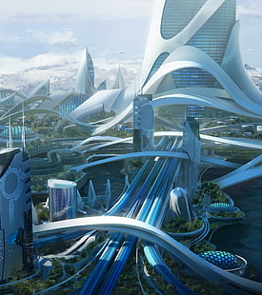
Today’s Class
Personality: Characters Vs. People
My Personality Trait
Mapping Yourself
Discussion

Slide 2
Understanding Personality
Authors use direct and indirect characterization to create characters. But what about real people?
How did your personality come to be?

Slide 3

Look back
How much of who we are today is
because of something that happened to us as children? Or do you think you were born
into your personality?

Slide 4
The Eldest Child: Responsible
As the oldest child, I had a lot of things on my shoulders!

Slide 5
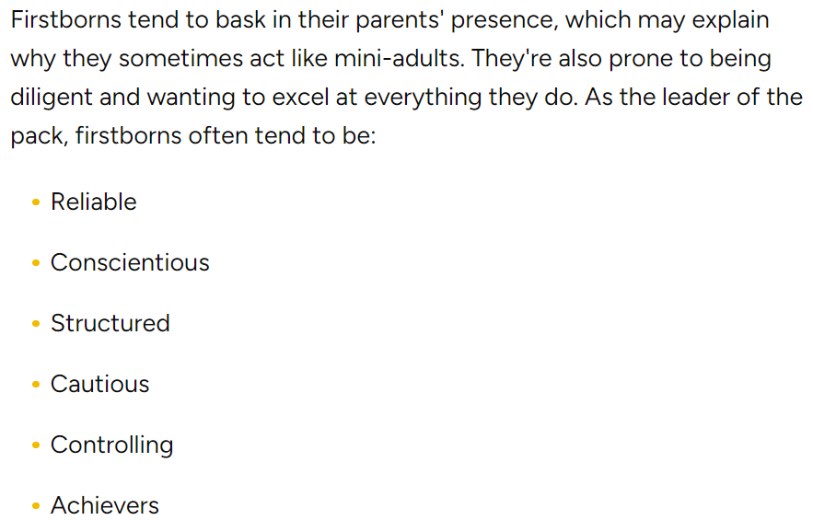

Slide 6
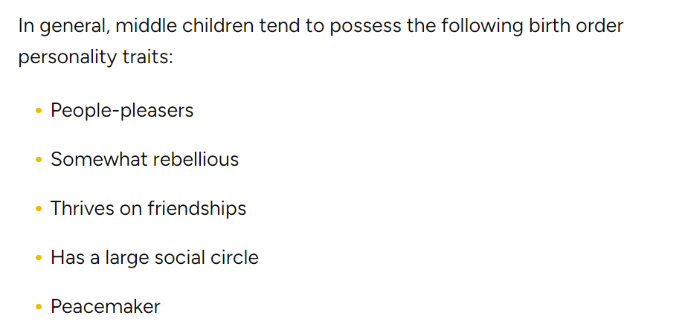

Slide 7
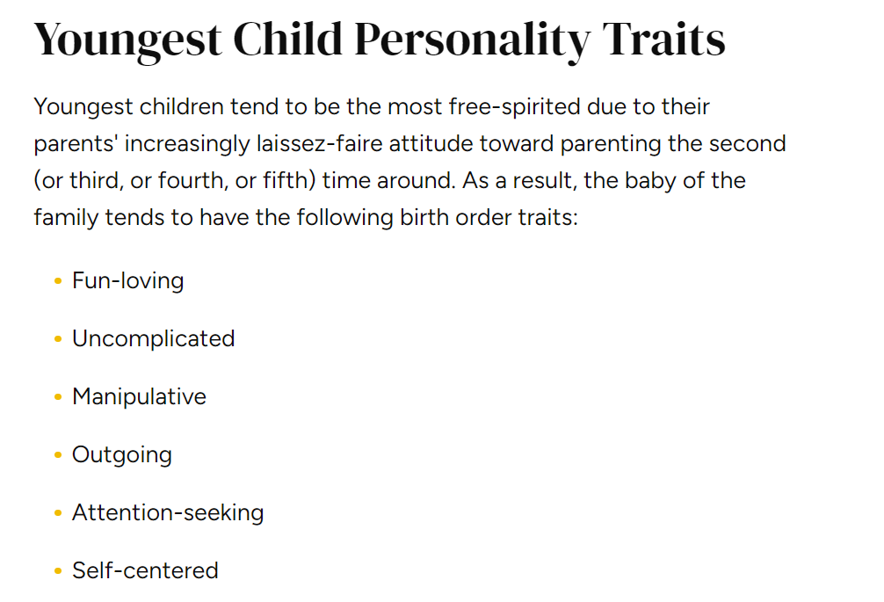

Slide 8
What about ONLY children?
Go on ManageBac and find the Task for the today and read the section on Only Children.
Do you agree?

Slide 9
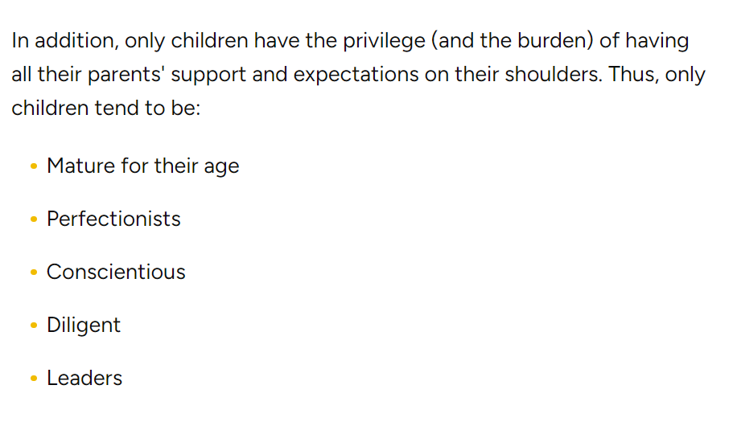

Slide 10
Mapping Yourself
A new trait since joining Pinghe School
Since becoming a teenager
A trait that has always been true
A trait you wish to have in the future.

Slide 11
Discussion
1.Do you believe a person’s personality is more shaped by
their environment (nurture) or by their genetics (nature)? Why?
2.Can people truly change their personality, or are core traits fixed for life?
What factors might cause a significant change in someone’s personality?
3.How much do you think society or cultural expectations shape
an individual's personality? Can people be different from the roles society expects them to play?
4. How do you think your perception of your own personality
differs from how others see you? Why might there be differences?

